Slide 1
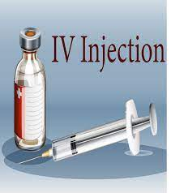
Fundamentals of Nursing(1st Stage)
Intravenous Injection (Practice)
Lecture 3
University of Basrah –College of Nursing – Fundamentals of Nursing Department

Slide 2
Introduction
Some medications must be given by an intravenous injection or infusion(I.V) . This means they’re sent directly into vein using a needle or tube. In fact, the term “intravenous” means “into the vein.

Slide 3
An I.V bolus: is one method of medication administration currently practiced on patient care units. It introduces a concentrated dose of a medication directly into a vein by way of an existing IV access. Administering medications by IV bolus is common in emergencies when deliver a fast-acting medication quickly. It is essential to monitor patients closely for adverse reactions because these medications act quickly.

Slide 4
Take into Account
The IV bolus is a dangerous method to administer medications because it allows no time to correct errors.
Administering an IV push medication too quickly can cause death. Therefore be very careful in calculating the correct amount of the medication to give.
A bolus may cause direct irritation to the lining of blood vessels; thus always confirm placement of the IV catheter or needle.
Never give an IV bolus if the insertion site appears edematous or reddened or if the IV fluids do not flow at the ordered rate.
Accidental injection of some medications into tissues surrounding a vein can cause pain, sloughing of tissues, and abscesses.

Slide 5
Uses of I.V injections
1-In some situations, people must receive medication very quickly. This includes emergencies, such as a heart attack, stroke, or poisoning. In these instances, taking pills or liquids by mouth may not be fast enough to get these drugs into the bloodstream. IV administration, on the other hand, quickly sends a medication directly into the bloodstream.
2-Medications may need to be given slowly but constantly. IV administration can also be a controlled way to give drugs over time.

Slide 6
3-Certain drugs may be given by IV administration because if you took them orally (by mouth), enzymes in your stomach or liver would break them down. This would prevent the drugs from working well when they’re finally sent to your bloodstream. Therefore, these drugs would be much more effective if sent directly into your bloodstream by IV administration.

Slide 7
Advantages of I.V Route
There is rapid onset of medication effects, which is useful in patients experiencing critical or emergent health problems.
Medications can be prepared quickly and given over a shorter time.
Doses of short-acting medications can be titrated based on a patient’s needs and responses to the drug therapy. This is important for infants, children, and older patients.
Method provides a more accurate dose of medication delivered because no medication is left in intravenously.

Slide 8
Disadvantage
Not all medications can be delivered by IV push.
There is higher risk for infusion reactions; some are mild to severe because the medication action peaks quickly.
When giving medication quickly (e.g., less than 1 minute), there is very little opportunity to stop the injection if an adverse reaction occurs.
Hypersensitivity reaction can cause an immediate or delayed systemic reaction to a medication, requiring supportive measures.

Slide 9
Best Practices for Administration of Intravenous Solutions and Medications
Use standardized concentrations and dosages of medication.
Use standardized procedures for ordering, preparing, and administering intravenous (IV) medications.
Administer solutions and medications prepared and dispensed from the pharmacy or as commercially prepared when possible.
Use standardized infusion concentrations of “high-alert” medications.
Standardize the storage of IV medications.
Use standardized label practices. Bold patient name, generic drug name, and patient-specific dose.

Slide 10
EQUIPMENTS
Syringe with needle.
Drug to be administered (without air).
Tourniquet.
Antiseptic hand rub, clean gloves.
Adhesive tape, antiseptic solution, and cotton wool.
Medication administration record (MAR)
Puncture-proof container

Slide 11
Nursing Diagnosis
Acute pain
Deficient knowledge regarding medication therapy

Slide 12
Procedure
Close room curtain or door
Identify patient using two identifiers (i.e., name and birthday or name and account number). Compare identifiers in MAR with information on patient’s identification bracelet and/or ask patient to state name.
At patient’s bedside again compare MAR with names of medications on medication labels and patient name.
Perform hand hygiene and apply clean gloves.
Identify best vein by applying light pressure to inject medication.
Apply tournique (4 to 6 inches) above proposed insertion site and clean insertion site with antiseptic solution in one circular motion. Allow to dry.
Insert needle in 45 degree and inspect for blood return into syringe which mean correct site.
Remove tournique and inject medication within amount of time recommended. Use watch to time administration.
After administering bolus, withdraw syringe
Dispose of covered needles and syringes in puncture-proof container.

Slide 13
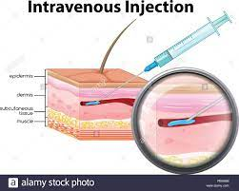

Slide 14
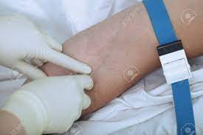

Slide 15
Signs of good vein | Veins should you avoid
Bouncy | Thromboses
Soft | Inflamed
Refills when depressed | Bruised
Visible | Thin
Has a large lumen | Near bony prominences
Straight | Areas or sites of infection, edema or phlebitis
Easily palpable | Have undergone multiple previous punctures.

Slide 16
Cannulation

Slide 17
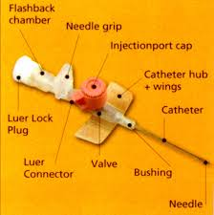
Intravenous cannula
Is a tube that can be inserted into a vein, primarily for the administration of intravenous fluids, obtaining blood samples and for administering medications.

Slide 18
Indications
Fluid and electrolyte replacement.
Administration of medications.
Administration of blood/blood product.
Administration of Total Parenteral Nutrition.
Blood sampling.

Slide 19
Size of intravenous cannula
Cannula come in various colors, which correspond to the size of the “tube”. The size needed depends on what it to be infused e.g. colloid, crystalloid, blood products
or medications; or at the rate the infusion is to run.
The other factor which could determine which size to use is the patients veins e.g. you may only get a small blue cannula into an elderly patient who has spindly veins.

Slide 20
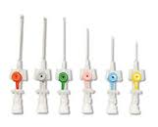

Slide 21
Size | Color
14G | Orange
16G | Grey
18G | Green
20G | Pink
22G | Blue
24G | Yellow
26G | Violet

Slide 22
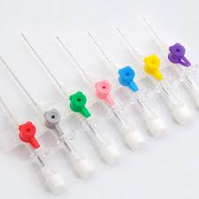

Slide 23
EQUIPMENTS
I.V cannula
Tourniquet.
Antiseptic hand rub, clean gloves.
Adhesive tape, antiseptic solution, and cotton wool.
Normal saline, syringe.

Slide 24
Procedure
Perform hand hygiene, applying clean gloves.
Select a well-dilated vein. Use most distal site in nondominant arm if possible
Apply tourniquet (4 to 6 inches) above proposed insertion site. Choose site that will not interfere with patient’s activities of daily living (ADLs).
Anchor vein below site by placing thumb over vein and gently stretching skin against direction of insertion 4 to 5 cm distal to the site. Instruct patient to relax hand.
Clean insertion site with antiseptic solution in one circular motion, allow to dry.
Insert bevel in 45 degree into vein and observe for blood return through flashback chamber of catheter, indicating that bevel of needle has entered vein.

Slide 25
Procedure
7. Loosen stylet of over-the-needle catheter. Continue to hold skin taut while stabilizing needle and advance catheter off needle to thread just the catheter into vein until hub rests at venipuncture site. Do not reinsert stylet once it is loosened.
8. Stabilize catheter with nondominant hand and release tourniquet with other. Apply gentle but firm pressure with middle finger of nondominant hand 3 cm above insertion site. Keep catheter stable with index finger.
9. Secure cannula, dispose stylet. Remove clean gloves and perform hand hygiene.

Slide 26
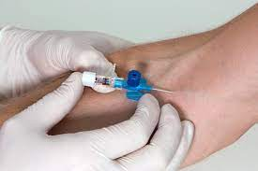

Slide 27
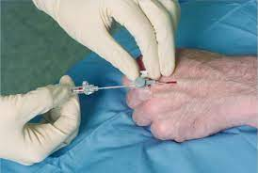

Slide 28
Possible Complication
1-Hematoma: a collection of blood, which can result from failure to puncture the vein when the cannula is inserted or when the cannula is removed.
2-Infiltration : when infuscate enters the subcutaneous tissue instead of the vein.
3-Embolism: this can be caused by air, a thrombus, or fragment of a catheter breaking off and entering the venous system.
4-Phlebitis: an inflammation of the vein resulting from mechanical or chemical irritation or from an infection.

Slide 29
Phlebitis Scale
Clinical Criteria | Grad
No symptoms | 0
Erythema at access site with or without pain | 1
Pain at access site with erythema and/or edema | 2
Pain at access site with erythema and/or edema Streak formation Palpable venous cord | 3
Pain at access site with erythema and/or edema Streak formation Palpable venous cord >1 inch (2.5 cm) in length Purulent drainage | 4

Slide 30
Thanks

